Slide 1

Kings County Housing
By: Rachel Spiro

Slide 2
GOAL: Predict Housing Prices In Kings County
Model: Multivariate Linear Regression
Variables:
Number Of Bedrooms
Number Of Bathrooms
Square Footage Of The Home
Square Footage Of The Lot
Total # Of Floors
Waterfront View
Overall Condition Of The House
Grade Based On KC Grading System
Number Of Times Viewed
Inclusion Of A Basement
Year Built
Year Renovated
Zipcode
Latitude
Longitude
Square Footage Of Nearest 15 Neighbors' Homes
Square Footage Of Nearest 15 Neighbors’ Lots

Slide 3
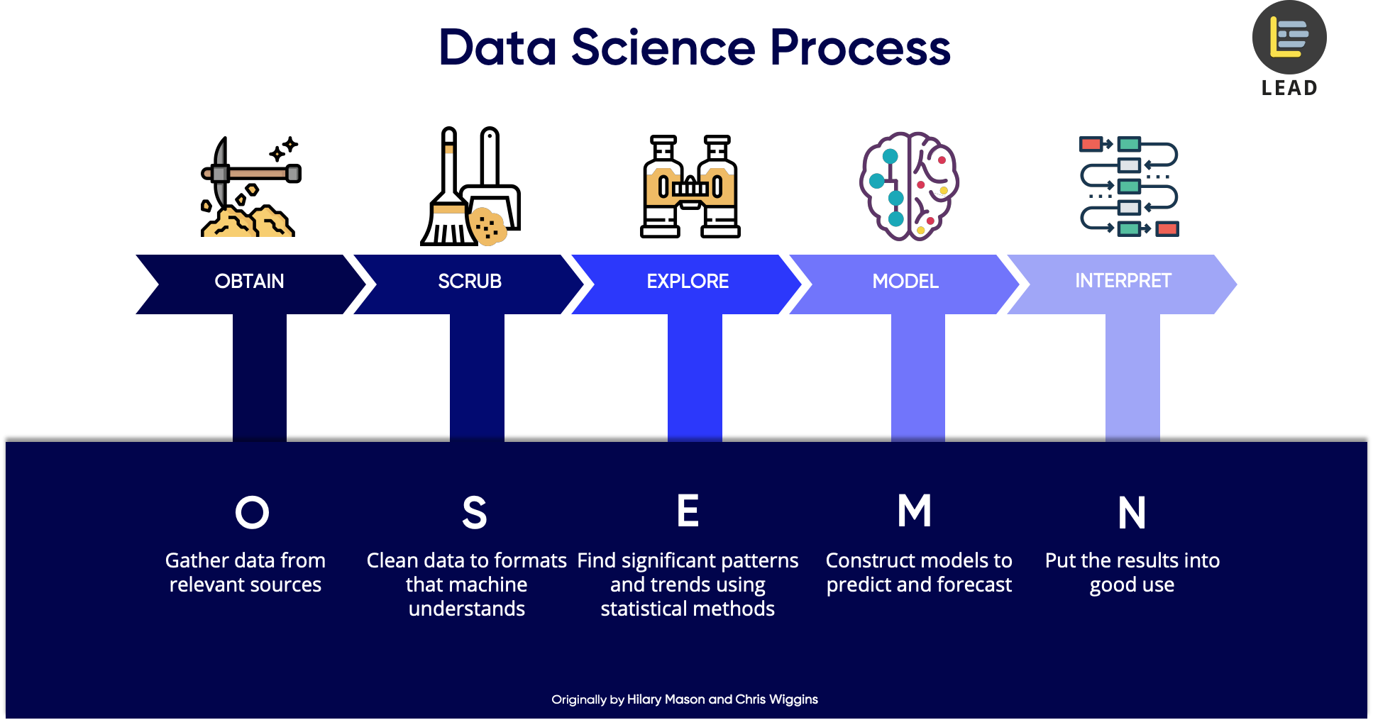
METHODOLOGY
Source:5 Steps of a Data Science Project Lifecycle

Slide 4
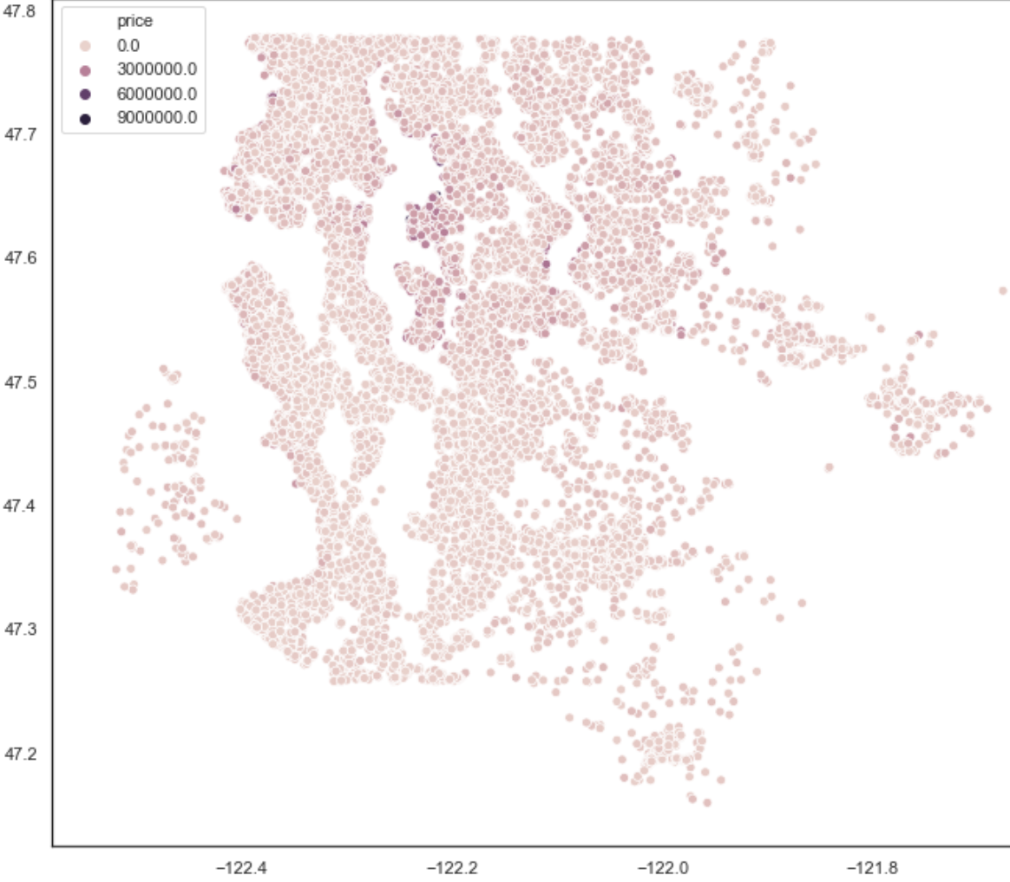
What is the best location?
Location vs. Price
Premium priced houses ($3,000,000+) tend to be located towards the outskirts of the more northern housing areas. There also is a cluster of them near 47.6 longitude and -122.2 latitude. Selling in one of these prime locations will be key to maximizing profit.
Longitude
Latitude

Slide 5
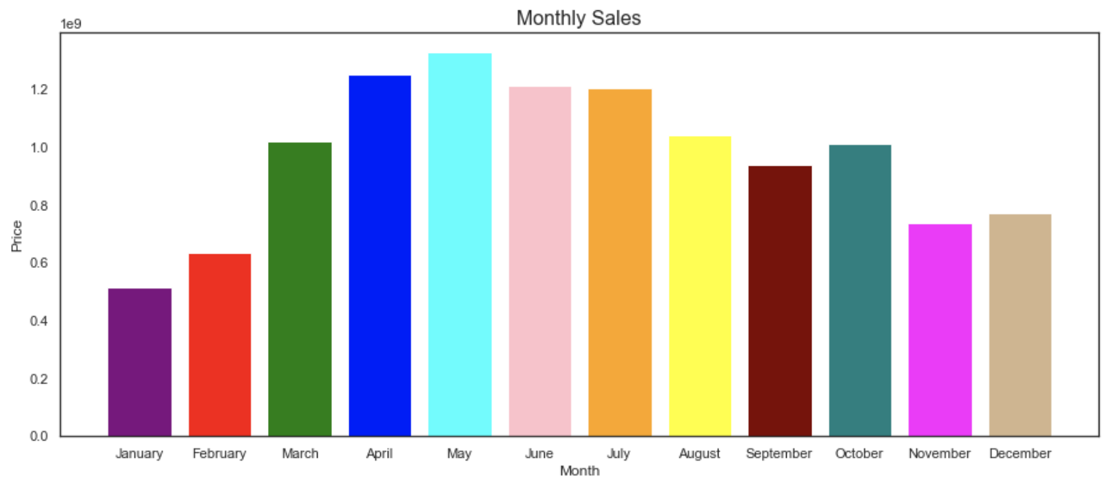
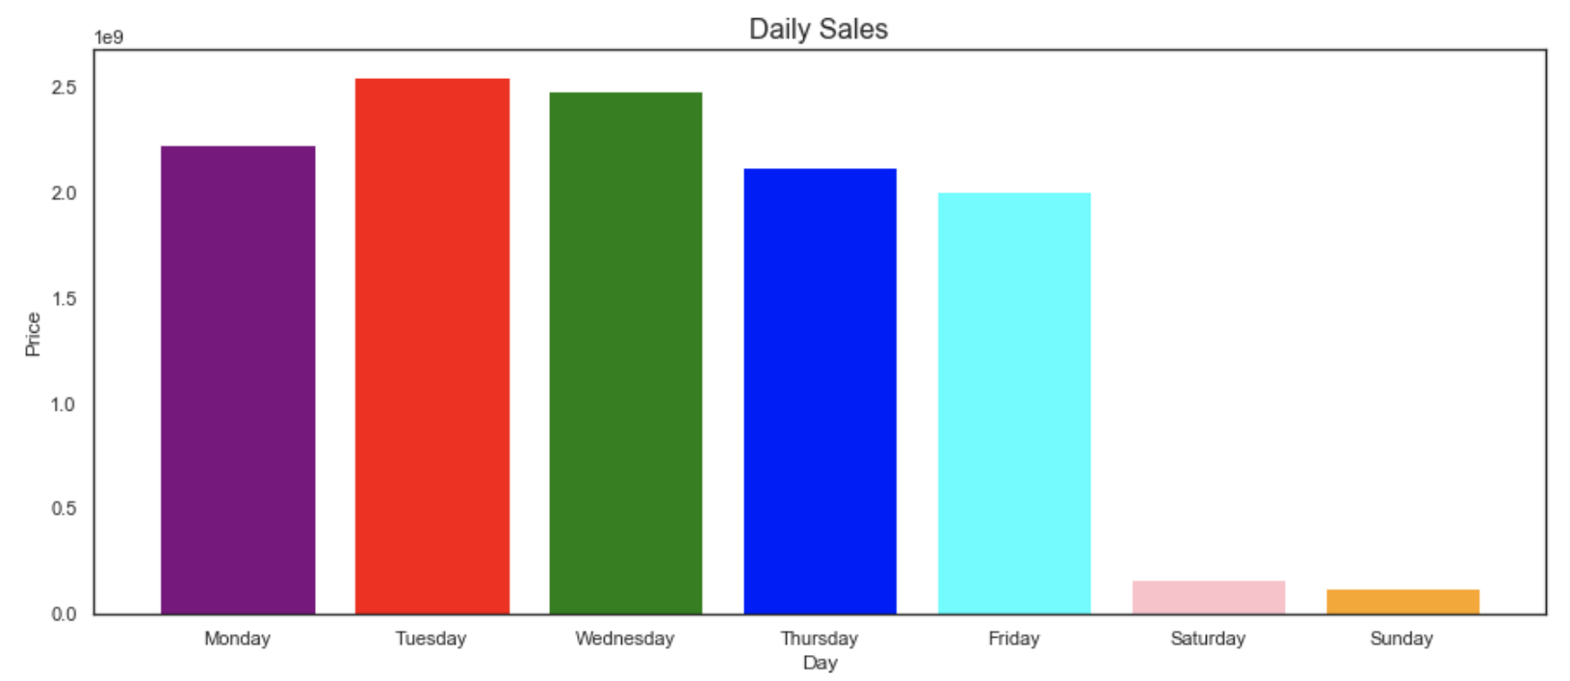
When is the best time of year to sell?
Sell during the spring/summer months to garner the greatest profit (March-August).
Selling on a weekday is advised as it brings in significantly more revenue than weekends.

Slide 6
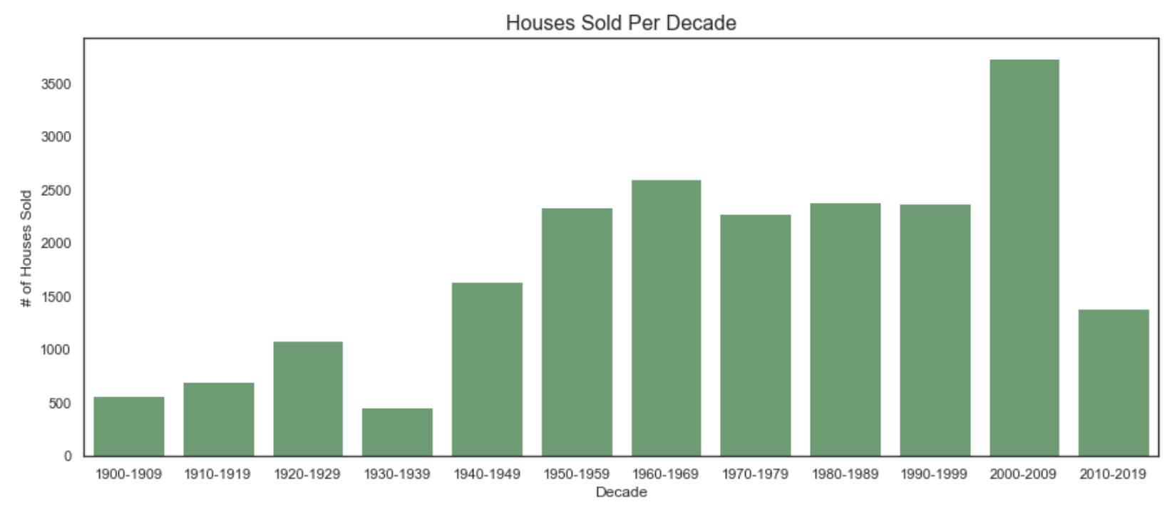
Do people prefer new or old homes?
Newly built or renovated houses (specifically within the last 15 years) are much more desirable.

Slide 7
What other factors have a strong influence on price?
Square footage of the house and neighboring houses – Larger houses sell for higher prices, especially when built near other large, expensive houses.
Grade of the house – More expensive homes often are given a higher grade rating from the town.
Number of Bathrooms – Homes with more bathrooms tend to be more expensive homes.
Waterfront View – Having a waterfront view can increase the value of a home.

